Slide 1
Pembelajaran Mesin dan Pembelajaran Mendalam #3 Supervised Learning
Semester Gasal 2024/2025
Prodi Informatika
Universitas Atma Jaya Yogyakarta

Slide 2
Outline
Classification and Regression
Classification Algorithms: KNN, Decision Tree, Random Forest, Gradient Boosting, Logistic Regression, Support Vector Machines
Regression: Linear Regression, Ridge, Lasso, Model-based Regressor

Slide 3
Machine Learning Models Simply Explained
https://youtu.be/yN7ypxC7838?si=F32xnhqypKB0TeVH
https://youtu.be/BT6Aw6Q75Yg?si=Sh_FyQgE9udXyPzQ

Slide 4

Classification and Regression

Slide 5
Classification
Predicting class labels: a selection from an existing list of possibilities
Binary classification: distinguish between two classes only. Ex: spam email or not
Multiclass classification: classification between more than two classes. Ex: irises: setosa, versicolor, or virginica

Slide 6
Regression
to predict continuous numbers, or floating-point numbers in programming terms (or real numbers in mathematical terms)
An easy way to differentiate between classification and regression tasks is there some kind of continuity in the output
Example: predicting a person's annual income from their education, their age, and where they live
the predicted value is a number, and can be any number within a specified range

Slide 7
Classification vs Regression
Difference between classification and regression [CLASSIFICATION & REGRESSION] 2021

Slide 8
K-Nearest Neighbors

Slide 9
K-Nearest Neighbors
The KNN algorithm is "lazy" because it does not work by learning functions that can form decision boundaries from data.
KNN learns from the training set by memorizing.
The KNN algorithm has the following working steps:
Selects the number k and the distance measurement method
Looking for k nearest neighbors from the train data set
Perform class predictions by voting the majority of the closest class for new data

Slide 10
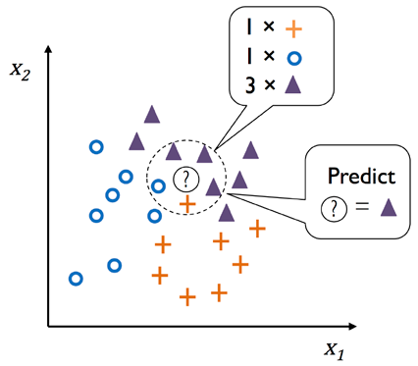
KNN Illustration
K Nearest Neighbors | Intuitive explained | Machine Learning Basics

Slide 11
K-Nearest Neighbors
KNN identifies the k closest data points in the training set to classify a new data point based on the majority class label among these neighbors.
Selecting the appropriate value of k is crucial to avoid overfitting (too small k) and underfitting (too large k), ensuring effective classification.
The distance measurement method must be suitable for the dataset's features; for instance, using Euclidean distance necessitates data standardization to ensure all features contribute equally.

Slide 12
K-Nearest Neighbors
The advantages of KNN are:
Easy to apply for simple cases
Quite reliable on unbalanced datasets
Simple model training process
The disadvantages of KNN are:
If the train set is large, the training process will take longer
Very sensitive to outliers in calculating the distance between data points
Cannot take into account the level of relevance or significance of features, if there are many features that are less important it will interfere with the learning process of the KNN model

Slide 13
Curse of Dimensionality
Curse of dimensionality is a phenomenon where the feature space increases in number of dimensions.
We can assume nearby data points to be too far away in higher dimensions to provide a good distance estimate.
Models such as KNN and Decision Tree cannot apply regularization so we need to use feature selection and feature reduction to help us avoid the curse of dimensionality.

Slide 14
KNN Code Ex
from sklearn.neighbors import KNeighborsClassifier
from sklearn.model_selection import GridSearchCV
KNN = KNeighborsClassifier()
pipe_KNN = Pipeline(steps=[(‘scale’,…),(‘feat_select’,…),(‘clf’,KNN)])
params_KNN = {‘feat_select__k’: …, ‘clf__n_neighbors’: list(range(1,6)),
‘clf__weights’:[‘uniform’, ’distance’],
‘clf__metric’:[‘euclidean’,’manhattan’,’minkowski’]}
GSCV_KNN = GridSearchCV(pipe_KNN,params_KNN,cv=5)
GSCV_KNN.fit(X_train,y_train)
GSCV_KNN.score(X_test,y_test)

Slide 15
Decision Trees

Slide 16
Decision Trees
Decision Tree is a model that is widely used for classification and regression tasks
The model learns if/else questions, leading to decisions
model for distinguishing between four classes of animals (eagles, penguins, dolphins, and bears) using the three characteristics "has feathers," "can fly," and "has fins."

Slide 17
Decision Trees
Building a Decision Tree:
The goal is to learn the sequence of if/else questions that lead to the quickest correct answer.
In machine learning, these questions are referred to as tests, not to be confused with test sets.
Unlike binary "yes/no" features, data is often represented as continuous features, such as in 2D datasets.

Slide 18
Decision Trees
Building a Decision Tree
The algorithm explores all potential tests to identify the one that provides the most information about the target variable.
This search is conducted recursively, building a structure that effectively narrows down choices.
The outcome of this process is a binary Decision Tree, where each node represents a specific test.

Slide 19
Decision Trees
Building a Decision Tree
The data is recursively divided until each region (leaf in the Decision Tree) contains only one target value.
A leaf is considered pure if all data points within it have the same target value (one class or one regression value).

Slide 20
Decision Trees
Building a Decision Tree
Predictions for a new data point are made by identifying the region it belongs to based on the feature space partition and then predicting the majority target value (or single target in pure leaves).
Regions are determined by traversing the Decision Tree from the root, moving left or right based on whether the test conditions are met.

Slide 21
Decision Trees
Building a Decision Tree
The last partition is too detailed = overfitting
Decision Tree: Important things to know

Slide 22
Decision Trees
Two methods to control complexity and prevent overfitting are pre-pruning (stopping tree construction early) and post-pruning (removing or collapsing nodes with little information).
Possible criteria for pre-pruning include limiting the maximum depth of the tree and limiting the maximum number of leaves.
Decision Trees in scikit-learn are implemented in the DecisionTreeRegressor and DecisionTreeClassifier classes, with only pre-pruning currently supported.

Slide 23
Decision Tree Code Ex
from sklearn.tree import DecisionTreeClassifier
from sklearn.model_selection import GridSearchCV
DT = DecisionTreeClassifier(random_state=0)
pipe_DT = Pipeline(steps=[(‘scale’,…),(‘feat_select’,…),(‘clf’,DT)])
params_DT = {‘feat_select__k’: …, ‘clf__criterion’: [‘gini’,’entropy’],
‘clf__max_depth’:[2,3,4,5]}
GSCV_DT = GridSearchCV(pipe_DT,params_DT,cv=5)
GSCV_DT.fit(X_train,y_train)
GSCV_DT.score(X_test,y_test)

Slide 24
Ensembles of Decision Trees
Ensembles combine multiple machine learning models to enhance overall model performance and accuracy.
Two notable ensemble models that utilize Decision Trees as their foundational elements are Random Forest and Gradient Boosted Trees.
Both Random Forest and Gradient Boosted Trees have demonstrated effectiveness across various datasets for tasks involving classification and regression.

Slide 25
Ensembles of Decision Trees
Random Forest consists of multiple Decision Trees, each slightly different from the others.
Each tree may perform well on certain data subsets, improving overall prediction accuracy.
Trees are randomized by selecting different data points for tree construction and by choosing features for each split test.

Slide 26
Ensembles of Decision Trees
Bootstrap Sampling: A random subset of data points is selected with replacement from the original dataset.
For a dataset ['a', 'b', 'c', 'd'], a bootstrap sample could be ['b', 'd', 'd', 'c'] or ['d', 'a', 'd', 'a’].
The same data point can be included multiple times in the bootstrap sample.

Slide 27
Ensembles of Decision Trees
A Decision Tree is constructed using the bootstrap sample created from the dataset.
The algorithm randomly selects a subset of features to identify the best test at each node.
This feature subset selection is performed independently at each node, allowing different nodes to utilize different feature subsets for decision-making.

Slide 28
Ensembles of Decision Trees
The algorithm makes predictions for each tree in the "forest" and then aggregates these results.
for regression, averaging the results per tree to get the final prediction
for classification, a “soft voting” strategy was used
Random Forest provides a more intuitive decision boundary, especially when using many trees (often hundreds or thousands), leading to finer bounds.
What is Random Forest?

Slide 29
Ensembles of Decision Trees

Slide 30
Ensembles of Decision Trees
Random Forest provides feature importances, which are calculated by combining the feature importances of each tree in the Random Forest

Slide 31
Ensembles of Decision Trees
Reliable, often works well without heavy parameter tuning, and does not require data scaling.
Tends to perform poorly on incomplete and very high-dimensional data, such as text data.
Requires more memory and is slower to train and predict than linear models.
Key Parameters to Adjust: n_estimators, max_features, and possibly pre-pruning options like max_depth.

Slide 32
Ensembles of Decision Trees
Gradient Boosting Tree - Sequential Tree Building: Each tree corrects the errors of the previous one.
Typically uses very shallow trees (depth 1-5), reducing memory usage and speeding up predictions.
By default, there is no randomization in a Gradient Boosting Tree; instead, strong prepruning is used

Slide 33
Ensembles of Decision Trees
The main idea behind Gradient Boosting Trees is to combine many simple models (in this context known as weak learners), such as shallow trees
Each tree can only provide good predictions on a portion of the data, and more trees are added to improve performance iteratively
Visual Guide to Gradient Boosted Trees (xgboost)

Slide 34
Ensembles of Decision Trees
The feature importance of Gradient Boosting Tree is somewhat similar to Random Forest, although Gradient Boosting Tree ignores some features

Slide 35
Ensembles of Decision Trees
One of the most powerful and widely used models for supervised learning
Requires careful parameter tuning and may take a long time to train
The main key parameters of the model are n_estimator, and learning_rate, which controls the extent to which each tree is allowed to correct the errors of the previous tree
max_depth (or alternatively max_leaf_nodes), to reduce the complexity of each tree

Slide 36
Random Forest Code Ex
from sklearn.ensemble import RandomForestClassifier
from sklearn.model_selection import GridSearchCV
RF = RandomForestClassifier(random_state=0)
pipe_RF = Pipeline(steps=[(‘scale’,…),(‘feat_select’,…),(‘clf’,RF)])
params_RF = {‘feat_select__k’: …,’clf__n_estimators’:[100,150,200],‘clf__criterion’: [‘gini’,’entropy’],‘clf__max_depth’:[2,3,4,5]}
GSCV_RF = GridSearchCV(pipe_RF,params_RF,cv=5)
GSCV_RF.fit(X_train,y_train)
GSCV_RF.score(X_test,y_test)

Slide 37
GradientBoostedTree Code Ex
from sklearn.ensemble import GradientBoostingClassifier
from sklearn.model_selection import GridSearchCV
GBT = GradientBoostingClassifier(random_state=0)
pipe_GBT = Pipeline(steps=[(‘scale’,…),(‘feat_select’,…),(‘clf’,GBT)])
params_GBT = {‘feat_select__k’: …,’clf__n_estimators’:[100,150,200],‘clf__criterion’: [‘friedman_mse’,’squared_error’],‘clf__max_depth’:[2,3,4,5],’clf__learning_rate’:[0.1,1,10]}
GSCV_GBT = GridSearchCV(pipe_GBT,params_GBT,cv=5)
GSCV_GBT.fit(X_train,y_train)
GSCV_GBT.score(X_test,y_test)

Slide 38
Logistic Regression

Slide 39
Logistic Regression
Logistic Regression is a basic but effective approach to linear and binary classification problems.
Even though it has the name 'regression', Logistic Regression is a classification model, not a regression model.
The workings behind Logistic Regression as a model for binary classification are based on 'likelihood’.

Slide 40
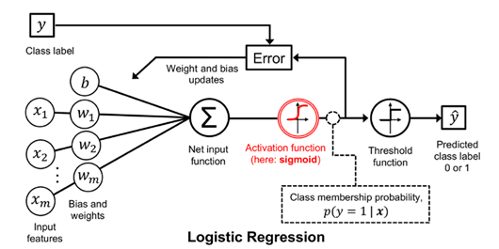
Logistic Regression
Logistic Regression applies a sigmoid function to the results of a linear equation of input variables and produces a probabilistic output ranging between 0 and 1.
A threshold value is applied to the output to classify new data into a certain class.

Slide 41
Logistic Regression
Logistic Regression has a parameter that determines the strength of regularization called C.
A higher value of C indicates less regularization factor. High C values try to adapt learning to the training set as best as possible (in more detail "trust" the training set).
A low C value makes the model place more emphasis on finding a coefficient vector (𝑤) that is close to zero (minimizing the influence of several features).
Logistic Regression in 3 Minutes

Slide 42
Logistic Regression
The advantages of Logistic Regression are:
Easy to implement and simple
Reliable for datasets with few to moderate features
The coefficients are easy to interpret
The disadvantages of Logistic Regression are:
Sensitive to outliers and imbalanced datasets
Not reliable on complex datasets
Interpretation of coefficients becomes difficult when there are correlated features

Slide 43
LogisticRegression Code Ex
from sklearn.linear_model import LogisticRegression
from sklearn.model_selection import GridSearchCV
LogReg = LogisticRegression()
pipe_LogReg = Pipeline(steps=[(‘scale’,…),(‘feat_select’,…),(‘clf’, LogReg)])
params_LogReg = {‘feat_select__k’: …,’clf__C’:[0.1,1,10],‘clf__penalty’: [‘l1’,’l2’]}
GSCV_LogReg = GridSearchCV(pipe_LogReg,params_LogReg,cv=5)
GSCV_LogReg.fit(X_train,y_train)
GSCV_LogReg.score(X_test,y_test)

Slide 44
Kernelized Support Vector Machine

Slide 45
Support Vector Machines
SVM studies how important each data point in the training set is to represent the decision boundary between two classes.
Only a small portion of the data points in the training set are considered important for determining decision boundaries. These data points are called support vector.
Support Vector Machine (SVM) in 7 minutes - Fun Machine Learning
https://youtu.be/Y6RRHw9uN9o?si=0wCT1Ng8jpAXdZKo
Support Vector Machine (SVM) in 2 minutes
https://youtu.be/_YPScrckx28?si=DfncGEc_TLkMPuoa

Slide 46
Support Vector Machines
To predict a new point, the distance between the new point and each support vector is measured.
Classification is based on the distance between the new point and the support vector and the level of importance of each support vector studied during training.
Classification decisions are made based on the distance to the support vector, and the importance of the support vector learned during training (stored in the dual_coef_ attribute of the SVC)

Slide 47
Kernelized Support Vector Machines
extensions that allow more complex models that are not defined solely by hyperplanes in the input space
One way to make a linear model more flexible is to add more features, by adding interactions or polynomials of the input features

Slide 48
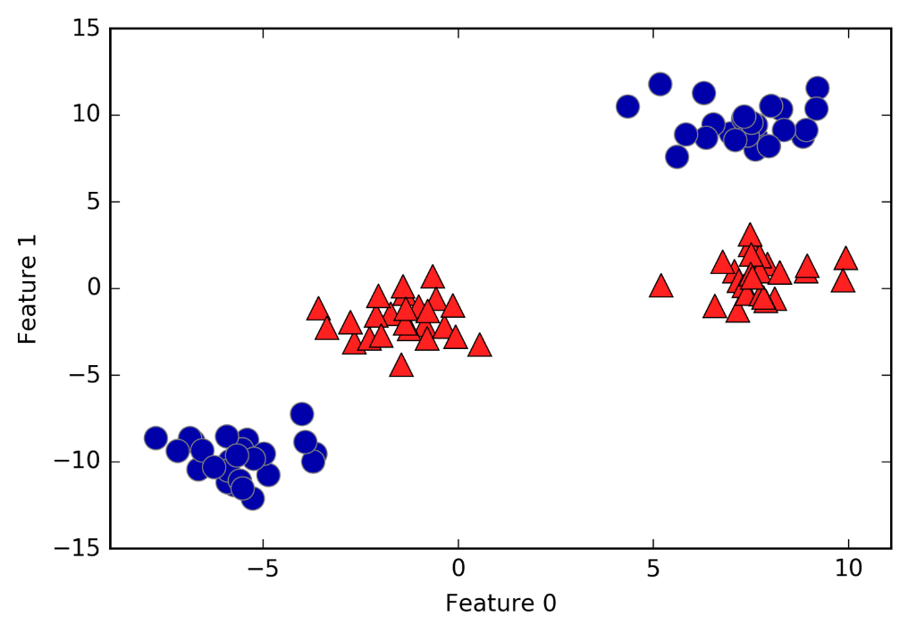
Kernelized Support Vector Machines
Two-class classification dataset where the classes are not linearly separable

Slide 49
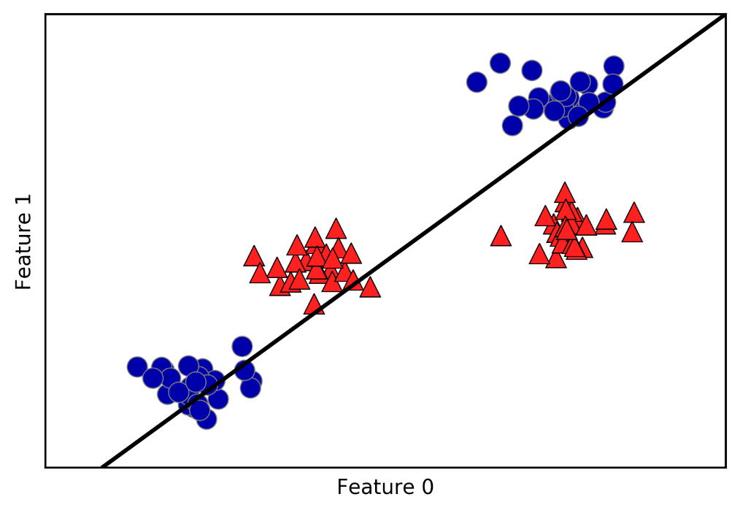
Kernelized Support Vector Machines
Linear models and nonlinear features
Decision boundaries created by linear SVM

Slide 50
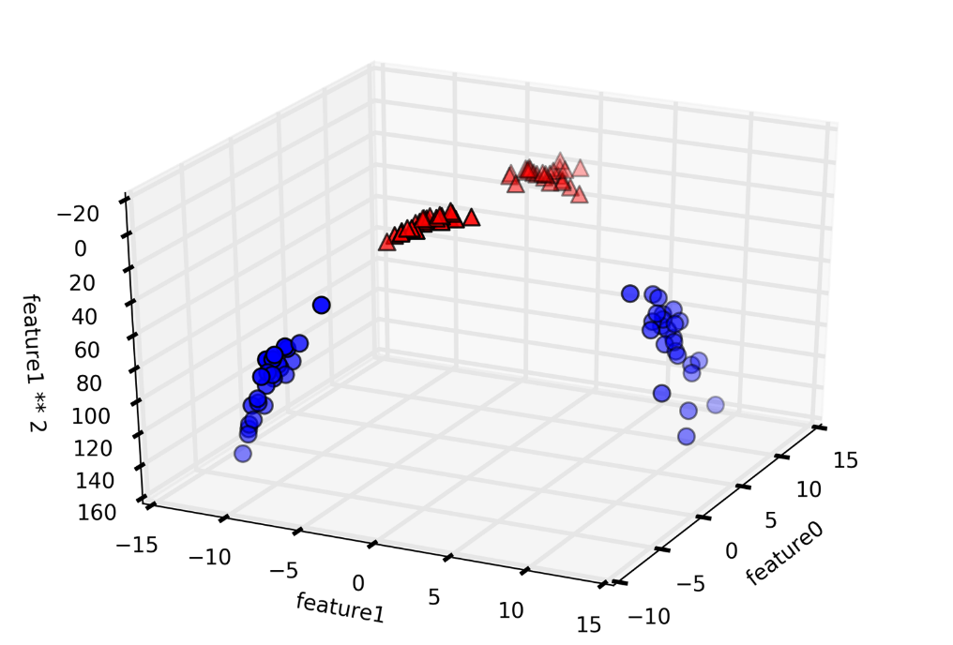
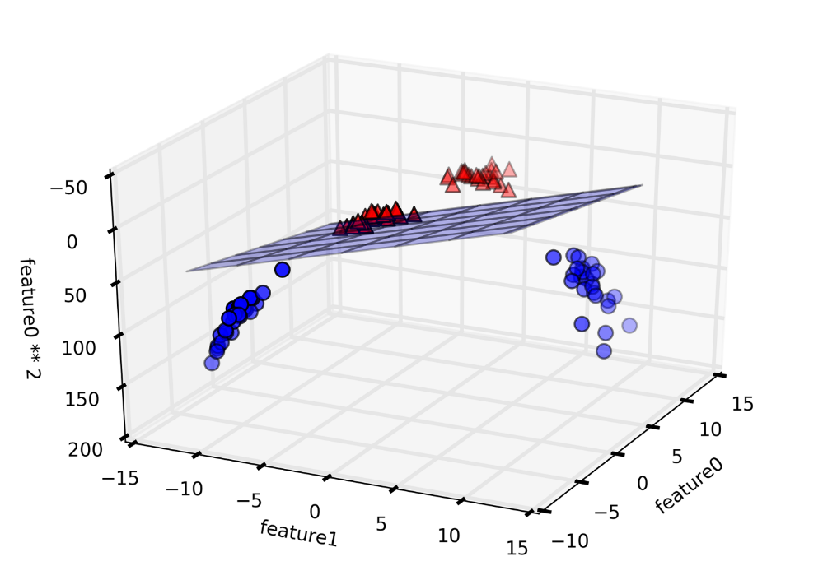
Kernelized Support Vector Machines

Slide 51
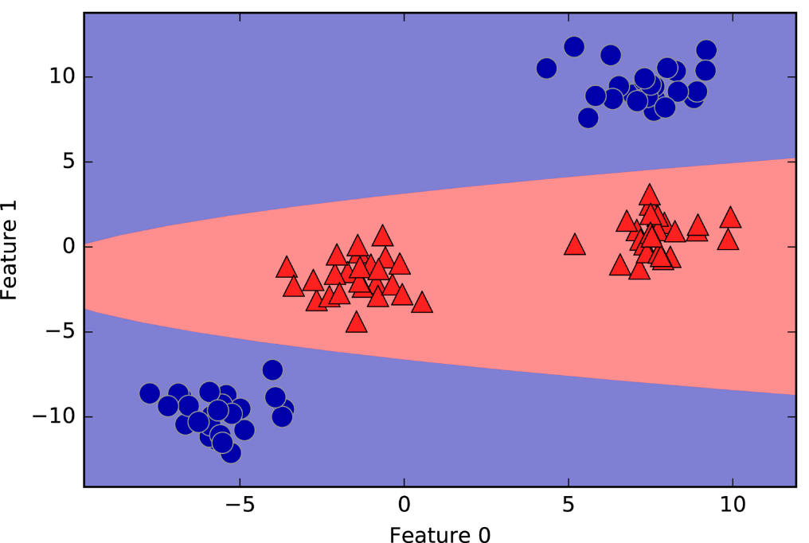
Kernelized Support Vector Machines
As a function of the original features, the linear SVM model is actually not linear anymore. It's not a line, but more like an ellipse

Slide 52
Kernelized Support Vector Machines
Kernel trick: mathematical trick that allows our classifier to learn in a higher dimensional space without actually computing a new representation which may be very large
works by directly calculating the distance (more precisely, the scalar product) of data points for an expanded feature representation, without ever actually calculating the expansion

Slide 53
Kernelized Support Vector Machines
Two ways to map your data to a higher dimensional space with SVM:
polynomial kernel, which computes all possible polynomials up to a certain level of the original feature (such as feature1 ** 2 * feature2 ** 5);
radial basis function (RBF) kernel, also known as Gaussian kernel
The Kernel Trick in Support Vector Machine (SVM)

Slide 54
Kernelized Support Vector Machines
The gamma parameter controls the width of the Gaussian kernel
determines the scale of what it means for points to be close together
The C parameter is a regularization parameter, similar to that used in linear models
limiting the importance of each point (or more precisely, dual_coef_)

Slide 55
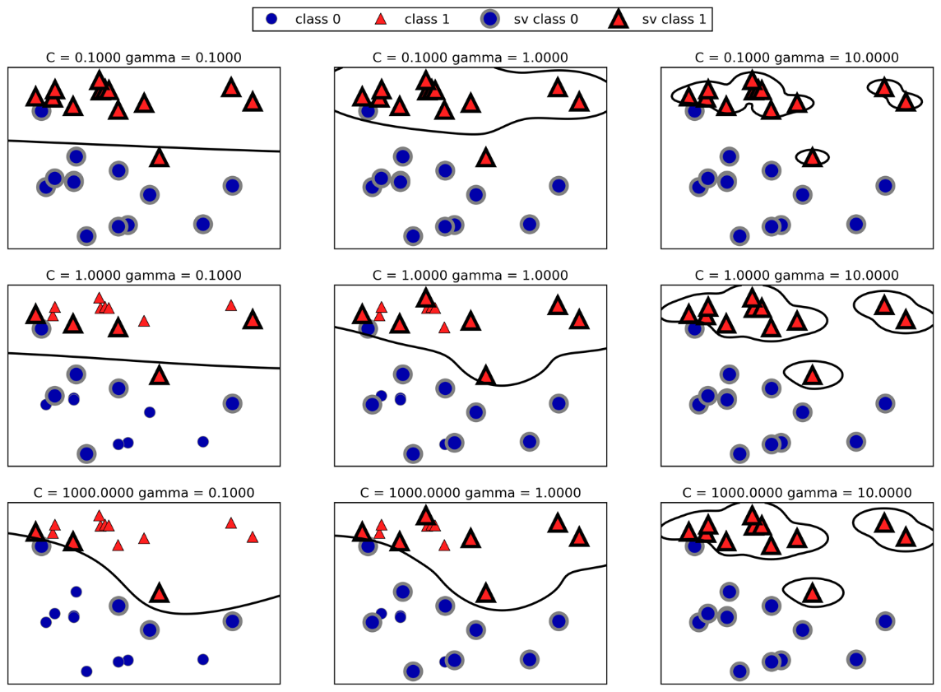
Kernelized Support Vector Machines

Slide 56
Kernelized Support Vector Machines
A small value of gamma means a large radius for the Gaussian kernel, which means many points are considered close
reflected in very fine decision boundaries on the left, and more focused boundaries at a single point further to the right
A low gamma value means the decision boundary will vary slowly, resulting in a model with low complexity, while a high gamma value results in a more complex model.

Slide 57
Kernelized Support Vector Machines
A small value of C means a very limited model, where each data point can only have a very limited influence
on the top left the decision boundary looks almost linear, with misclassified points having almost no influence on the line
increasing C, as shown in the bottom right, allows these points to have a stronger influence on the model and makes the decision boundary bend to classify them correctly

Slide 58
Kernelized Support Vector Machines
Strengths, weaknesses and parameters
SVM is a powerful model and performs well on a variety of datasets
SVM allows complex decision boundaries, even if the data only has a few features. SVM performs well on low-dimensional and high-dimensional data (i.e., few and many features), but does not scale very well with sample size
Running SVM on data with 10,000 samples may work fine, but working with datasets of 100,000 or more, can be challenging in terms of runtime and memory usage

Slide 59
Kernelized Support Vector Machines
Another disadvantage of SVMs is that they require careful data pre-processing and parameter tuning
Additionally, SVM models are difficult to examine; it may be difficult to understand why certain predictions are made, and it may be difficult to explain the model to non-experts
The important parameters in the SVM kernel are the regularization parameter C, kernel choice, and kernel specific parameters

Slide 60
SVC Code Ex
from sklearn.svm import SVC
from sklearn.model_selection import GridSearchCV
SVMClf = SVC()
pipe_SVM = Pipeline(steps=[(‘scale’,…),(‘feat_select’,…),(‘clf’, SVMClf)])
params_SVM = {‘feat_select__k’: …,’clf__C’:[0.1,1,10],‘clf__gamma’: [0.1,1,10], ‘clf__kernel’: [‘rbf’,’poly’,’sigmoid’]}
GSCV_SVM = GridSearchCV(pipe_SVM,params_SVM,cv=5)
GSCV_SVM.fit(X_train,y_train)
GSCV_SVM.score(X_test,y_test)

Slide 61
Regression

Slide 62
Regression
Regression in supervised learning is a method used to model the relationship between the independent variable (X) and the dependent variable (y) by looking for mathematical equations.
Regression has the aim of predicting the value of the dependent variable based on the value of the independent variable.

Slide 63
Regression
An easy way to differentiate between classification and regression tasks: is there some kind of continuity in the output
Example: predicting a person's annual income from their education, their age, and where they live
The predicted value is a quantity, and can be any number within a specified range

Slide 64
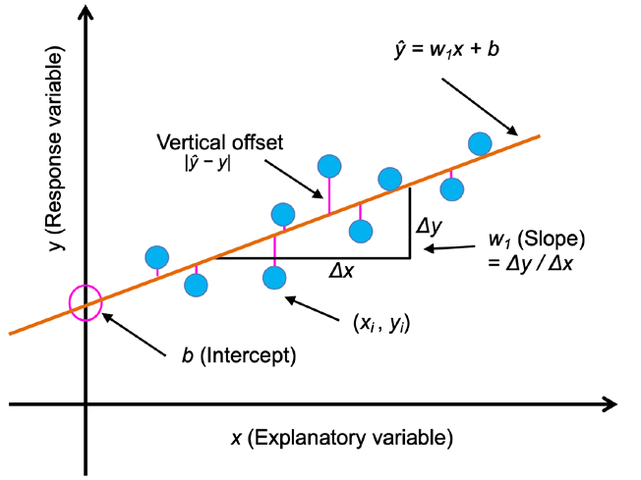
Regression Illustrated

Slide 65
Linear Regression
one of the simplest and most frequently used regression methods.
Linear Regression works by looking for the best straight line (linear) that can describe the relationship between the independent (X) and dependent (y) variables.
Linear Regression calculates the w and b parameters that minimize the Mean Squared Error between the prediction and the actual regression target.
https://youtu.be/CtsRRUddV2s?si=3k1p6OloDF-Fb3mY

Slide 66
Linear Regression
Advantages: simple and easy to understand, can provide accurate results on linear datasets, relatively fast computing time.
Disadvantages: cannot overcome non-linear relationships, cannot overcome multicollinearity (the existence of correlation or strong relationship between two or more independent variables in a regression model. Significant to the predicted value by coefficient b).

Slide 67
Lasso
Lasso and Ridge regression techniques were developed to overcome multicollinearity and overfitting problems in linear regression models.
Both techniques work by imposing a penalty on the regression equation.
Lasso uses the L1 penalty, creating a simpler model by focusing on the most important features and discarding minor features.
The Lasso model also limits the coefficient w to approach zero.
https://youtu.be/eGXw9n7AnV4?si=I8JqoEQTpSYbFFa-

Slide 68
Lasso
Advantages: can create simplified models, select the most important features, and avoid overfitting.
Disadvantages: often ignores features that have no impact on the dependent variable and may produce an unstable model.

Slide 69
Lasso Regression Code Ex
from sklearn.linear_model import Lasso
from sklearn.model_selection import GridSearchCV
LS = Lasso(max_iter=1000)
pipe_LS = Pipeline(steps=[(‘scale’,…),(‘feat_select’,…),(‘reg’, LS)])
params_LS = {‘feat_select__k’: …,’reg__alpha’:[0.01,0.1,1,10]}
GSCV_LS = GridSearchCV(pipe_LS,params_LS,cv=5,scoring=‘neg_mean_absolute_error’)
GSCV_LS.fit(X_train,y_train)
GSCV_LS.score(X_test,y_test)

Slide 70
Ridge
Ridge uses the L2 penalty by reducing regression coefficients and addressing multicollinearity to produce a more stable model.
The coefficient value is made as small as possible; all w values must be close to zero.
Each feature should have as little effect as possible on the results (which means a small slope if graphed), but should still predict well.
https://youtu.be/OEU22e20tWw?si=o2fMPv4rNGzG-TUU

Slide 71
Ridge
Advantages: Ridge can eliminate multicollinearity and create a more stable model.
Disadvantages: cannot ignore insignificant features and tends to build complicated models.

Slide 72
Ridge Regression Code Ex
from sklearn.linear_model import Ridge
from sklearn.model_selection import GridSearchCV
RR = Ridge()
pipe_RR = Pipeline(steps=[(‘scale’,…),(‘feat_select’,…),(‘reg’, RR)])
params_RR = {‘feat_select__k’: …,’reg__alpha’:[0.01,0.1,1,10]}
GSCV_RR = GridSearchCV(pipe_RR,params_RR,cv=5,scoring=‘neg_mean_absolute_error’)
GSCV_RR.fit(X_train,y_train)
GSCV_RR.score(X_test,y_test)

Slide 73
Model-based Regressor: SVR
SVR is a machine learning technique for regression tasks, extending the principles of Support Vector Machines (SVM) from classification to regression.
Epsilon (ε) controls the margin width, and regularization parameter C controls the trade-off between achieving a small margin and minimizing training error.

Slide 74
Model-based Regressor: SVR
Handling Nonlinear Relationships: SVR can model complex nonlinear relationships using kernel functions.
Tolerance of Errors: SVR allows for a specified tolerance margin (ε), making it robust to outliers.

Slide 75
SVR Regression code ex
from sklearn.svm import SVR
from sklearn.model_selection import GridSearchCV
SVR_reg = SVR(kernel=‘linear’)
pipe_SVR = Pipeline(steps=[(‘scale’,…),(‘feat_select’,…),(‘reg’, SVR_reg)])
params_SVR = {‘feat_select__k’: …,’reg__C’:[0.01,0.1,1,10], ‘reg__epsilon’:[0.1,0.2,0.5,1]}
GSCV_SVR = GridSearchCV(pipe_SVR,params_SVR,cv=5,scoring=‘neg_mean_absolute_error’)
GSCV_SVR.fit(X_train,y_train)
GSCV_SVR.score(X_test,y_test)

Slide 76
Model-based Regressor: GBR
Gradient Boosting Regressor is a machine learning technique that builds trees sequentially to correct the errors of the previous tree.
Each tree tries to improve the predictions of the previous tree.
Uses very shallow trees with a depth of one to five, reducing memory usage and speeding up predictions.

Slide 77
Model-based Regressor: GBR
Efficient Decision Boundaries: Gradient Boosting Regressor provides a more intuitive decision boundary, especially when using many trees.
Robustness: It is robust to outliers and can handle complex relationships between variables.

Slide 78
GBR Regression code ex
from sklearn.ensemble import GradientBoostingRegressor
from sklearn.model_selection import GridSearchCV
GBR_reg = GradientBoostingRegressor()
pipe_GBR = Pipeline(steps=[(‘scale’,…),(‘feat_select’,…),(‘reg’, GBR_reg)])
params_GBR = {‘feat_select__k’: …,’reg__n_estimators’:[100,200,300], ‘reg__learning_rate’:[0.01,0.1,1],’reg__max_depth’:[3,4,5]}
GSCV_GBR = GridSearchCV(pipe_GBR,params_GBR,cv=5,scoring=‘neg_mean_absolute_error’)
GSCV_GBR.fit(X_train,y_train)
GSCV_GBR.score(X_test,y_test)

Slide 79
Tambahan Referensi
Introduction to Machine Learning
https://www.wolfram.com/language/introduction-machine-learning/classic-supervised-learning-methods/

